Slide 1

Scripting Languages
Module 8
curl, wget and Manipulating Data Using Awk

Slide 2
Contents
wget and curl
Using AWK for text manipulation
AWK Variables
AWK conditional statements
Combining logical expressions and text parsing with AWK
Using functions in AWK
Creating awk scripts

Slide 3
Learning Objectives
After finishing this module, you should be able to:
Execute scripts that use wget and curl
Execute scripts that use AWK
Process streams using either sed or AWK or a combination of the two
Execute scripts that use AWK to process strings and real numbers
Use AWK in conjunction with other commands such as grep and sed, and utilising regular expressions to produce required solutions

Slide 4


wget and curl

Slide 5
wget
wget is a utility for non-interactive download of files from the web. It supports HTTP, HTTPS and FTP
wget can follow HTML/XHTML links and reproduce a local version of remote website, duplicating the directory structure precisely in a process known as recursive downloading
The most fundamental way to use wget is to provide it with the address of a file you wish to download to your local machine
EXAMPLE:
$ wget https://www.asite.com/pdfs/prod_brochure.pdf
This command would download the file into the same directory that the .sh script is running in

Slide 6
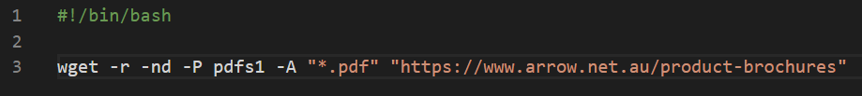
wget
3
1
2
4
 | Command | Full Name | Function
1 | r | --recursive | Turn on recursive retrieving. The default maximum depth is 5.
2 | nd | --no-directories | Do not create a hierarchy of directories when retrieving recursively. With this option turned on, all files will get saved to the current directory unless another directory is specified
3 | P prefix | --directory-prefix=prefix | Set directory prefix to prefix. The directory prefix is the directory where all other files and subdirectories will be saved to, i.e. the top of the retrieval tree. The default is . (the current directory).
4 | A acclist | --accept acclist | Specify comma-separated lists of file name suffixes or patterns to accept. If any of the wildcard characters, *, ?, [ or ], appear in an element of acclist, it will be treated as a pattern, rather than a suffix. The pattern must be enclosed in quotes to prevent shell expansion.

Slide 7
curl
curl supports piping and operates similarly to the cat command, passing data to stdout and accepting data from stdin
curl performs single-shot transfers of data and user-specified URLs, and does not possess recursive downloading or HTML parsing capability
curl supports more protocols that wget (HTTP, HTTPS and FTP support only) including FTPS, Gopher, SCP, SFTP, TFTP, TELNET, DICT, LDAP, LDAPS, FILE, POP3, IMAP, SMB/CIFS, SMTP, RTMP and RTSP
curl supports more HTTP authentication methods, especially over HTTP proxies: Basic, Digest, NTLM and Negotiate as well as several SOCKS protocol versions for proxy access
curl is bidirectional possessing upload and sending capabilities, HTTP multipart/form-data sending, gzip and deflate Content-Encoding and automatic decompression

Slide 8
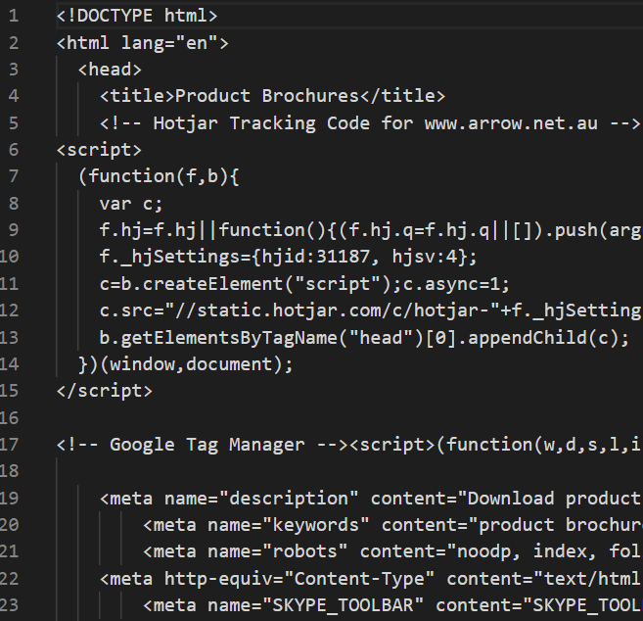
curl
This command downloads the .htm/.html/.php file (code) the URL points to and writes it to a file named temp.txt on-the-fly
The –s means silent, which suppresses the curl download connection and progression data from being echoed to the screen.

Slide 9
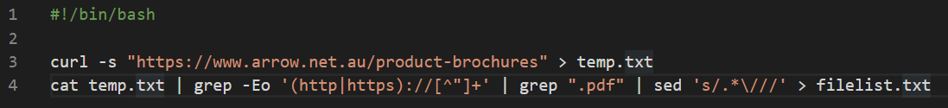
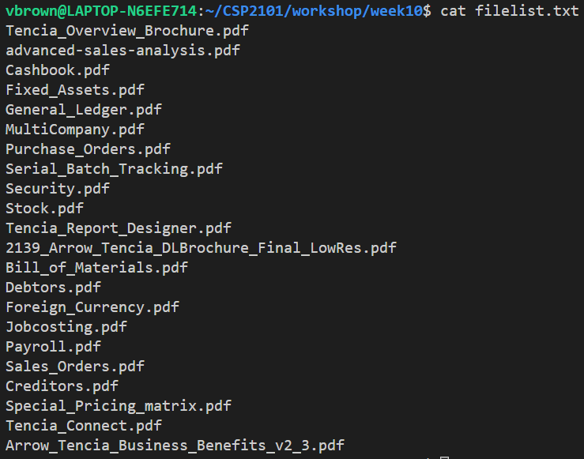
Curl applied
Acquire URL file (code)
Write to text file
Pass contents of text file to grep to:
Strip all non-url elements
Strip all lines that don’t contain “.pdf”
Strip all paths leaving only the file names themselves

Slide 10
Introduction to awk

Slide 11
awk
AWK is a highly-versatile utility that can be used to perform a wide range of useful tasks within the bash environment, including:
Text processing,
Producing formatted text reports,
Performing arithmetic operations,
Performing string operations
Unlike other key utilities such as sed and grep, AWK is actually an entire programming language in its own right, in which you can:
Define variables
Use string and arithmetic operators
Use control flow and loops

Slide 12
awk History
AWK was first developed by bell labs in the 1970s
It was named after the three programmers who originally designed it Alfred Aho, Peter Weinberger and Brian Kernighan (AWK)
Over the years there have been many different implementations of awk, but the two most common forms in use today are:
gawk (used in linux based systems)
BWK (used in bsd and MacOS based systems)

Slide 13
The AWK workflow
Execute commands within the BEGIN block
Read a line from the input stream
Execute commands on the current line
IF
Not End of File
REPEAT
End of File
Execute commands within the END block

Slide 14
awk default variables

Slide 15
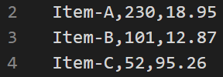
AWK Default Variables
Variable | Purpose
$0 | Entire record
$1 | Field #1 in record
$2 | Field #2 in record
$3 | Field #3 in record
…and so on
NF | Stores # fields in record
NR | Stores line number of each record
FS | File separator
$0
$1
$2
$3
NF(3)
NR(4)
FS(,)

Slide 16
awk Structure

Slide 17
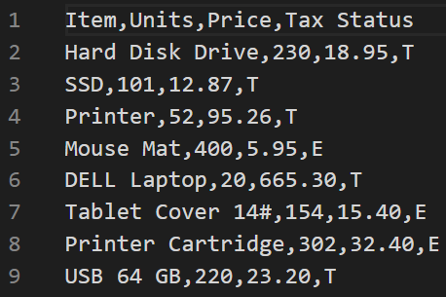
The AWK Structure
awk BEGIN {awk-commands}
/pattern/ {commands}
END {awk-commands}
optional elements
We will use the data in salesdata.csv to demonstrate awk in action

Slide 18
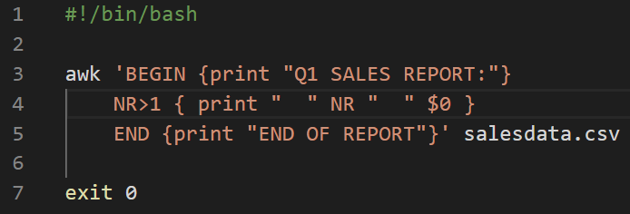
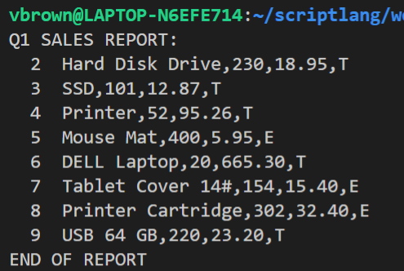
The awk pattern-command structure
1
BEGIN pattern: Actions awk will execute once before any input lines are read. The BEGIN pattern is optional.
MAIN PATTERN/ACTION: Specifies what is to be done with each line, or specific fields within each line contained with the data handed to awk. One or more statements within curly braces { } are compulsory.
END pattern: Actions awk will execute once after any input lines are read. The END pattern is optional.
The DATA SOURCE: Specified after the close }’ of the awk structure if data has not be piped through prior from another process
2
3
4

Slide 19
awk Formatting

Slide 20
printf format codes
Code | Result
%s | String
%5s | String with a minimum of 5 characters
%f | Number (floating point)
%5f | Number with a minimum of 5 characters
%5.2f | Number with a minimum of 5 characters and 2 decimal places
%d | Whole number (Decimal Integer)
%c | Single Character

Slide 21
awk in action

Slide 22
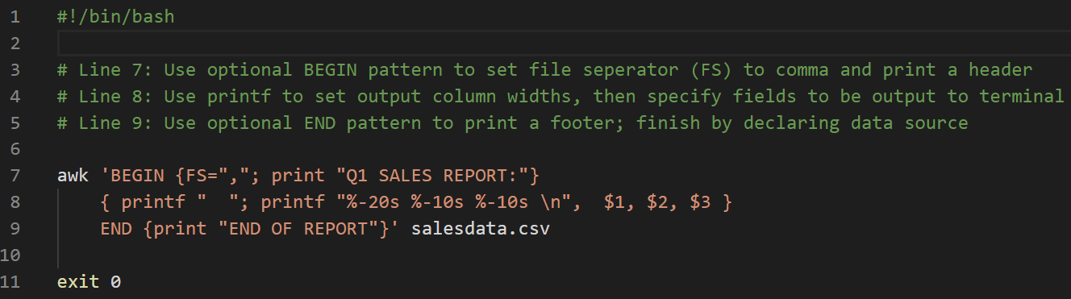
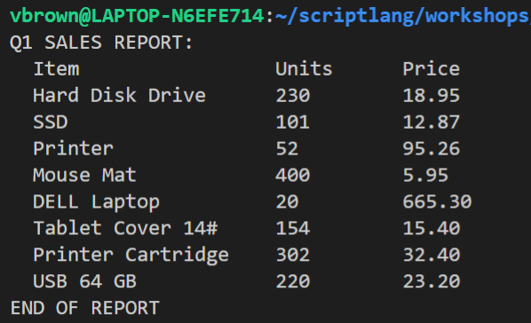
Setting the field separator and output format
1
2
The FS=“,” pattern tells awk that the field separator in the data source is a comma
The %-20s %-10s %-10s \n pattern provides awk with the formatting pattern of the field output commands that immediately follow

Slide 23
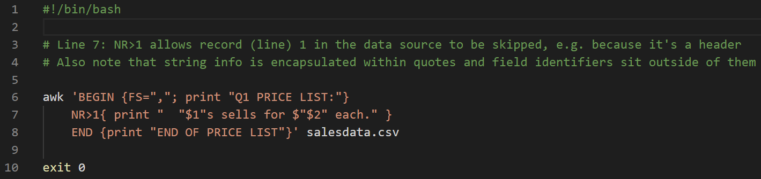
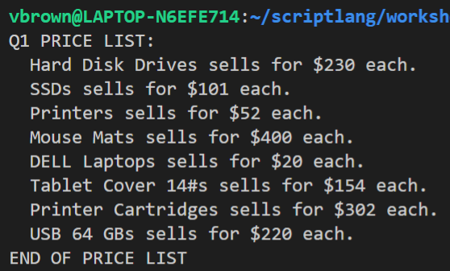
Specifying records and inserting string info
1
2
The NR>1 test tells awk to skip the first record (line) in the source file, in this case because it is an unwanted header
Also note that string info is encapsulated within quotes “ “ and field identifiers, e.g. $1 $2 sit outside of them

Slide 24
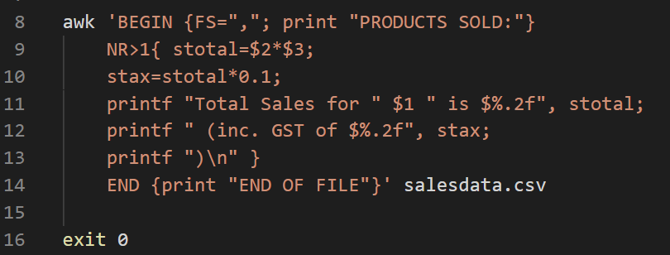
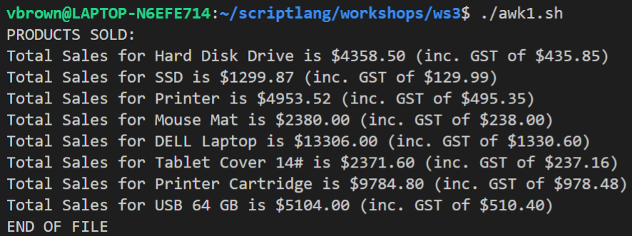
Declared variables and output formatting
2
1
Line 9: Declare a variable named stotal to which product of field $2 and field $3 is assigned
Line 10: Declare a variable named stax to which 10% of stotal is assigned
Line 11: Print product name and its sales total to terminal formatted to two decimal places
Line 12: Print GST component to terminal formatted to two decimal places
Note:
The %.2f code formats the value that follows, i.e. stotal to two (2) decimal places
‘Programmer declared’ awk variables do not use the $ prepend, either when declared or when used in awk command sequences

Slide 25
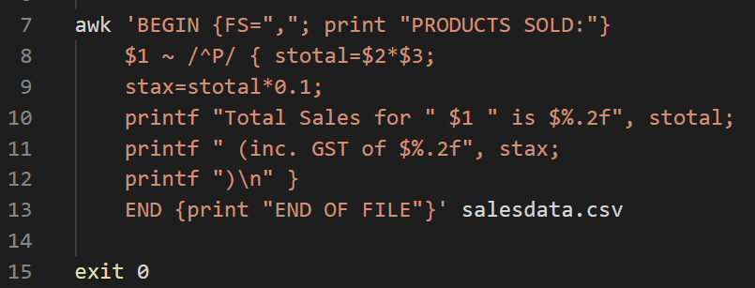
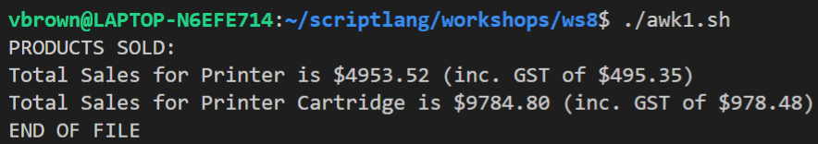
Identifying specific records based on a regex
1
2
Line 8: Declares a pattern that determines which records (lines) will be acted upon by awk commands. The pattern in this case is those records (lines) in which field $1 starts with uppercase P. The pattern is placed immediately before awk's main command block, i.e. just before the opening {
Note:
The ~ symbol in the context means contains. !~ inverts this, i.e. does not contain
In awk, the regular expression pattern is delimited by forward slashes /^P/

Slide 26
awk Conditional Statements

Slide 27
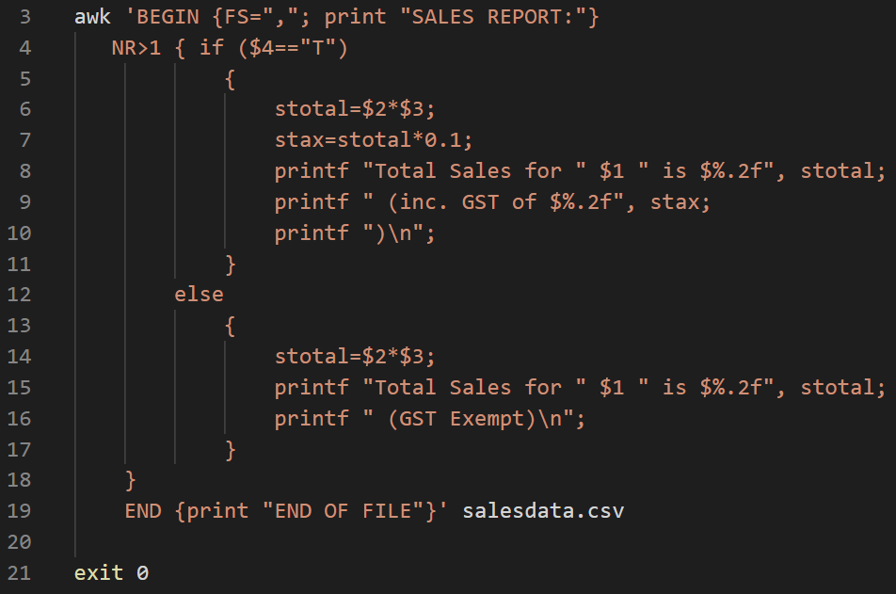
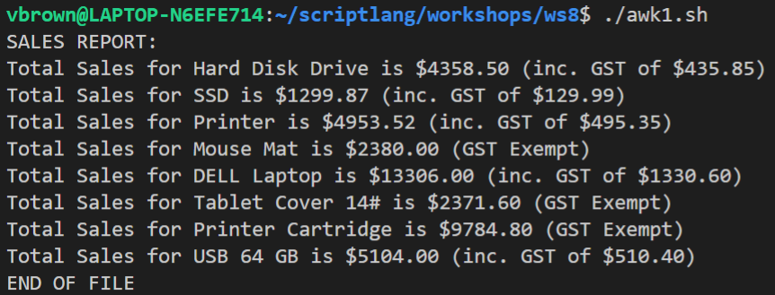
Using an IF control structure in awk
2
1
3
4
Logical test is encapsulated within started parenthesis
Assignations differ from shell script, more like PHP and others
Command must be enclosed in { } (unless only one command)
Commands must be terminated with semi-colon ;
If structure does not require close statement, e.g. endif
5
Note:
If more than two (2) options apply, then else if (condition-x) is used

Slide 28
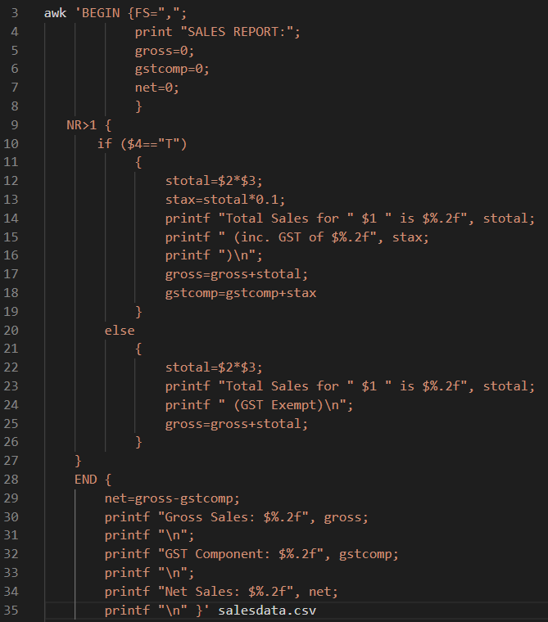
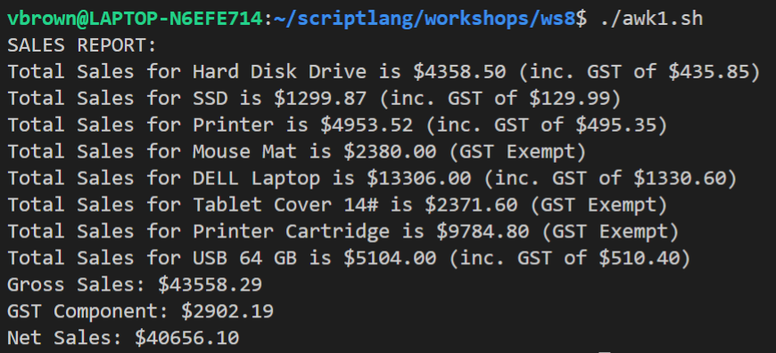
A more complex awk example
1
The optional BEGIN statement can be used to declare and initialise variables that are to be used across all records collectively, rather than record by record, e.g. gross, gstcomp and net
The optional END statement can be used to calculate totals after all records have been processed for summary purposes
2

Slide 29
awk Functions

Slide 30
Functions
Function | Purpose
sin() | Sine
cos() | Cosine
tan() | Tangent
sqrt() | Square root
exp() | Exponential
log() | Logarithm
rand() | Random Number Generator
length() | String length
split() | String splitter
toupper() | Convert string to uppercase
tolower() | Convert string to lowercase
Functions in awk behave in a similar way to functions in bash
Just like shell script, awk functions are useful for breaking scripts up into logical modules and reducing the need for repeated code

Slide 31
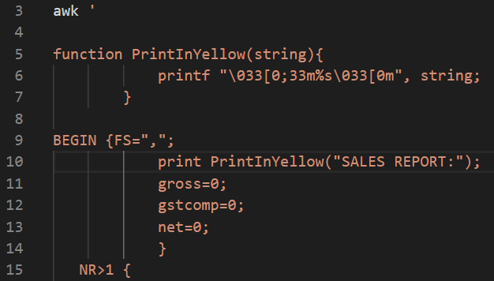
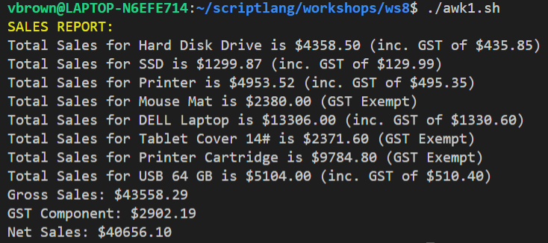
Custom awk functions
1
2
Declare the custom function immediately after awks opening single parenthesis ‘
Apply the functions in the awk command body as required

Slide 32
Integrating awk
in shell scripts

Slide 33
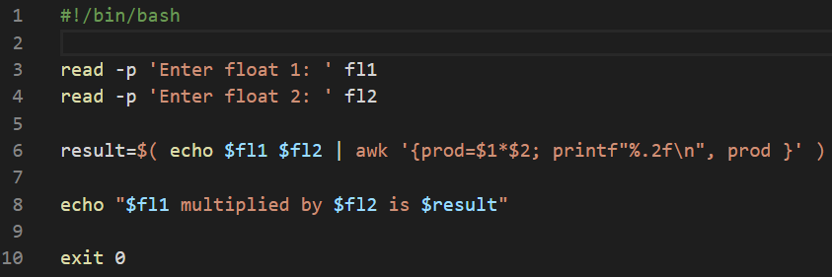
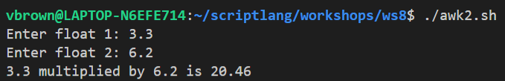
Using awk to work with floats 1
1
2
3
Uses command substitution to immediately assign the results of command sequence to a variable named $result
Echo used to provide stored inputs ($fl1, $fl2) to awk via piping
Then awk makes the required calculations, the product of which is stored in $result

Slide 34
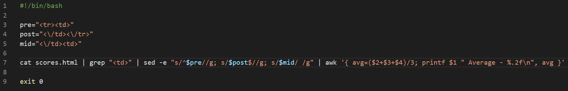
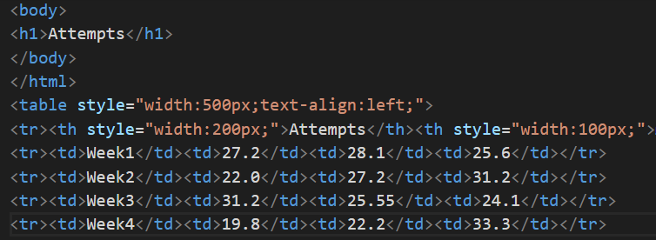
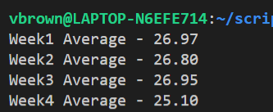
Using awk to work with floats 2
1
2
3
4
Grab the content of scores.html and pipe it through to grep
Use grep to eliminate all lines passed to it except those that contain <td> and then pipe through to sed
Use sed to eliminate all remaining HTML tags, ensuring that the </td></td> sequence is replace by a space, then pipe the results to awk
Use awk to calculate the averages of the float values on each of the four records that remain and print to the terminal formatted to two (2) decimal places

Slide 35
References and Further Reading
Ebrahim, M. and Mallet, A. (2018) Mastering Linux Based Scripting (2nd Ed.), Chapters 10, 12, 13
https://likegeeks.com/awk-command
https://www.tutorialspoint.com/awk/awk_built_in_functions

Slide 36
Terms to Review and Know
wget and curl
regex in awk
If statements in awk
Functions in awk
awk scripts
awk formatting
parsing
fields
records
printf

